Slide 1

Hard Creditor Retainers
Authorizations Team

Slide 2
What is a hard creditor?
Does not negotiate with debt settlement companies
Settlements are less favorable
Clients need to be involved in the settlement process.

Slide 3
What we say in the enrollment agreement
“Difficult Creditors”: Certain creditors are more difficult to negotiate with than others, some substantially so. The presence of an enrolled debt with a difficult creditor may result in a less favorable settlement for that particular debt than the same debt with a non-difficult creditor. If your enrolled accounts consist of one or more creditors which are known or believed to be “difficult creditors,” a greater degree of personal involvement may be required from you in order to obtain the best possible settlement. Though we are committed to handling every possible aspect of your debt negotiation agreement and will make the initial outreach to difficult creditors when necessary, you may be required to directly communicate or negotiate with a difficult creditor. In such an instance, we will work with you on a case-by-case basis to formulate an appropriate method for approaching these creditors, including providing you with step by step instructions to follow and an appropriate negotiated settlement range.

Slide 4
Why sign a retainer?
Chase/Amex/Wells Fargo have stated that they will only negotiate with a law firm who represents the client in this matter. (Enrolled before 03/09/2023 )Greenberg Law or (Enrolled after 03/09/2023) Alperstein & Associates LLC has agreed to offer to represent you for the limited purpose of contacting Chase/Amex/Wells Fargo to assist in the negotiations process. This is what is called Limited Representation. There is no cost to the client for this, and there is nothing more that they need to do.
This way the client does not need to be involved in the negotiations process. Sometimes that means being on the phone for an hour or more.

Slide 5
Talking Points
Why am I signing a retainer?
  This retainer will allow (Enrolled before 03/09/2023 )Greenberg Law or (Enrolled after 03/09/2023) Alperstein & Associates LLC to contact these more difficult creditors (Chase/Amex/Wells Fargo) and obtain settlements without needing to get you involved in the actual settlement process.
What does this mean for me?
  Creditors such as Chase, Wells Fargo and American Express will not settle directly with a debt settlement company, they require you to be on the line as well, however, they will settle with a law firm. This retainer makes it so that (Enrolled before 03/09/2023 )Greenberg Law or (Enrolled after 03/09/2023) Alperstein & Associates LLC will be able to assist us in contacting that creditor and will not require for you to be on the phone. This is at no additional cost to you.
Are you going to represent me if I get sued?
  No, this retainer is simply to help us secure settlements on these creditors through the program.

Slide 6

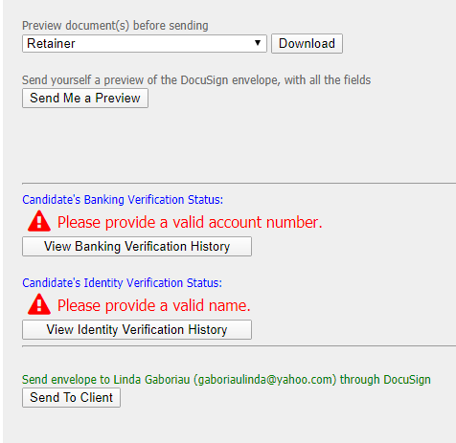
How do we send retainers?
Click on the retainer needed link on the client page
A new window will pop up
Click send to client, if there is a co-client 2 emails will be sent
Confirm retainer uploaded to client files
  If not done automatically check your email for DocuSign to manually upload

